Slide 1

Exploratory Soil‑Moisture EDA
Cleaning, features and modelling from Jul–Oct 2023
September 22, 2025

Slide 2
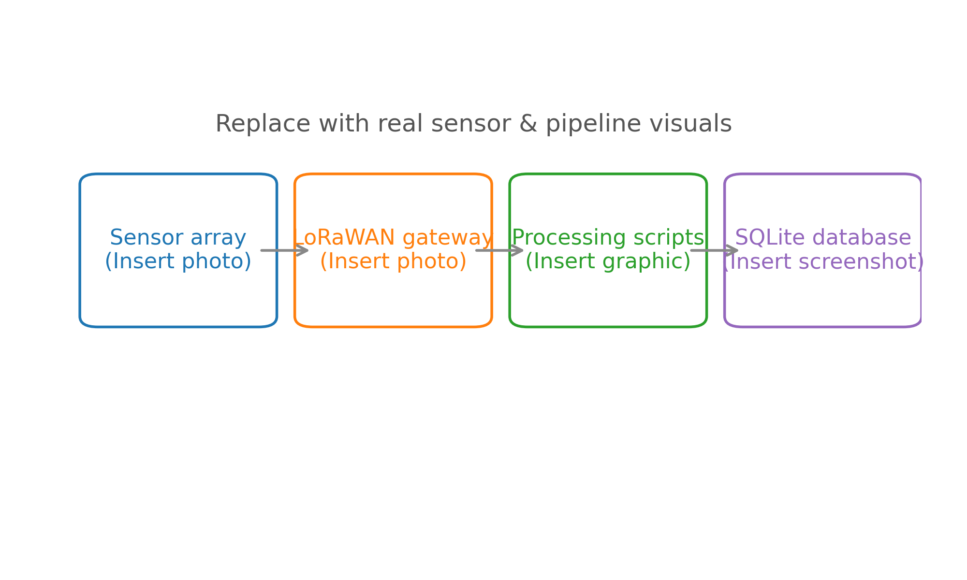
Sensors to SQLite: data flows
Sensors installed in 36 plots record volumetric water content at multiple depths (6″, 18″, 30″).
Data travels via LoRaWAN gateways into our processing scripts and finally lands in a SQLite database.
Automation pipelines handle ingestion, monitoring and storage for the 2023 growing season.

Slide 3
Ingest overview: Jul 19 – Oct 13 2023
37 704 hourly rows spanning 36 plots with soil moisture and weather readings.
Temporal coverage: July 19 through October 13 2023, capturing the late‑summer irrigation period.
Targets include surface (6”), mid (18”) and deep (30”) VWC as well as auxiliary weather variables.

Slide 4
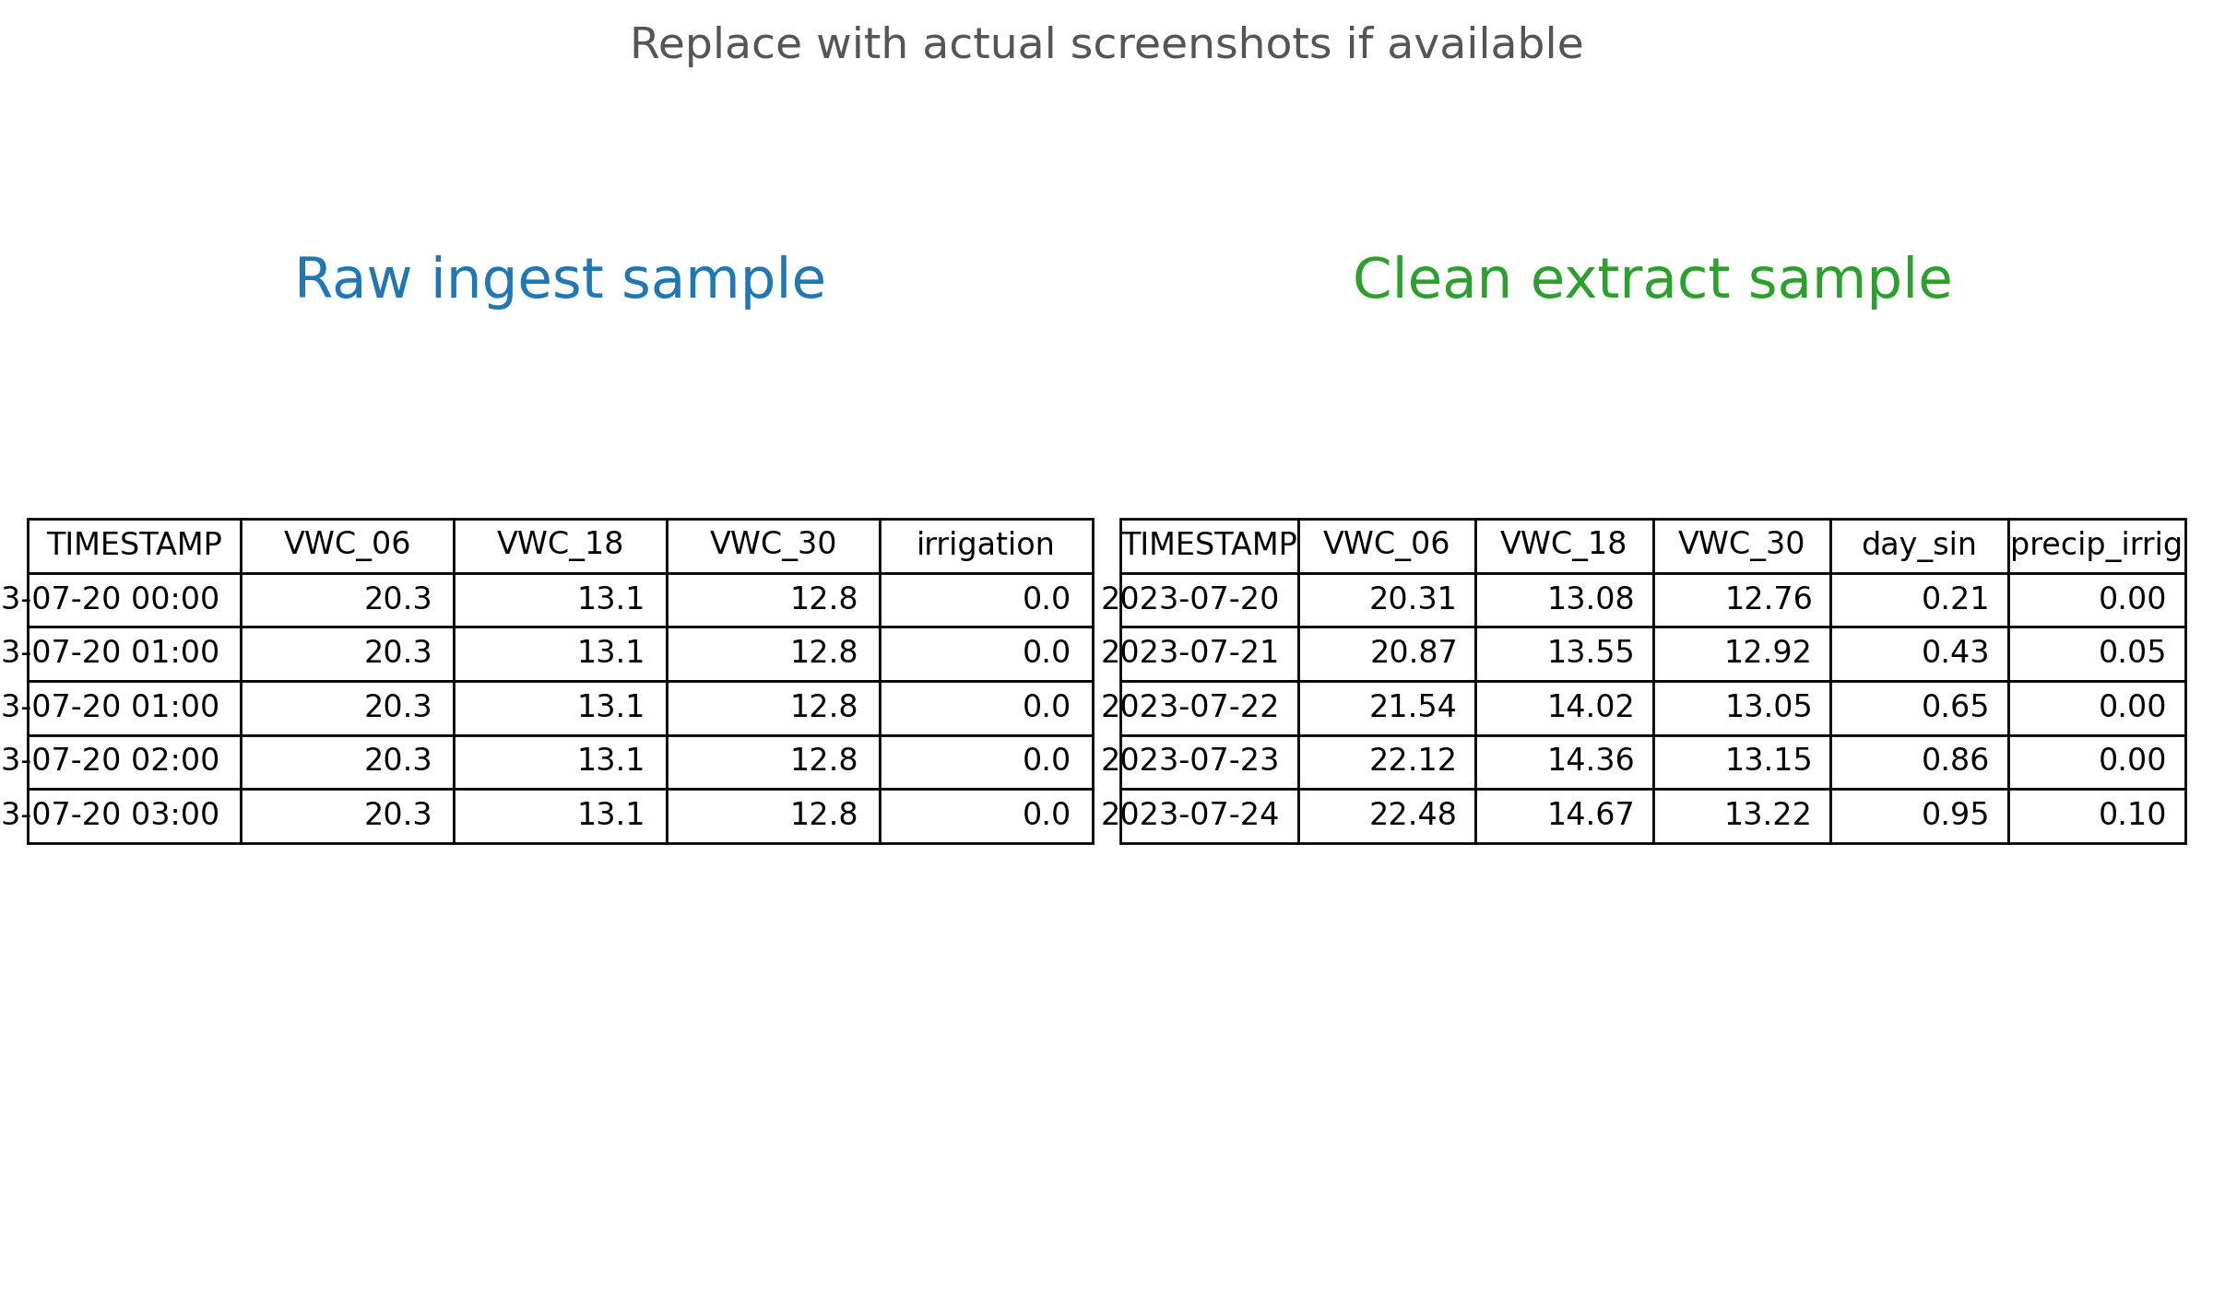
Raw feed vs cleaned series
Hourly ingestion contains duplicates, flat‑lines and missing timestamps.
We resample to daily averages, interpolate gaps and trim obvious outliers.
Cleaning produces a smooth foundation for feature engineering and modelling.

Slide 5
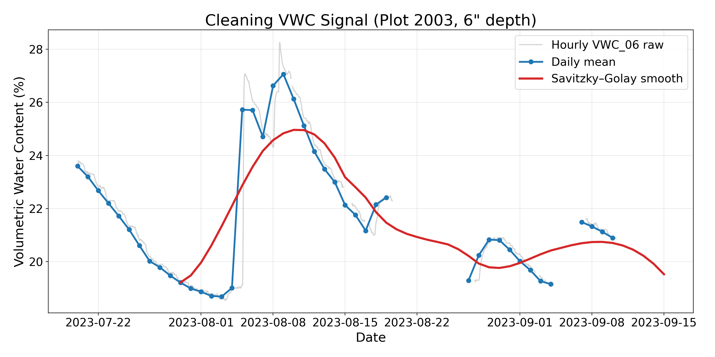
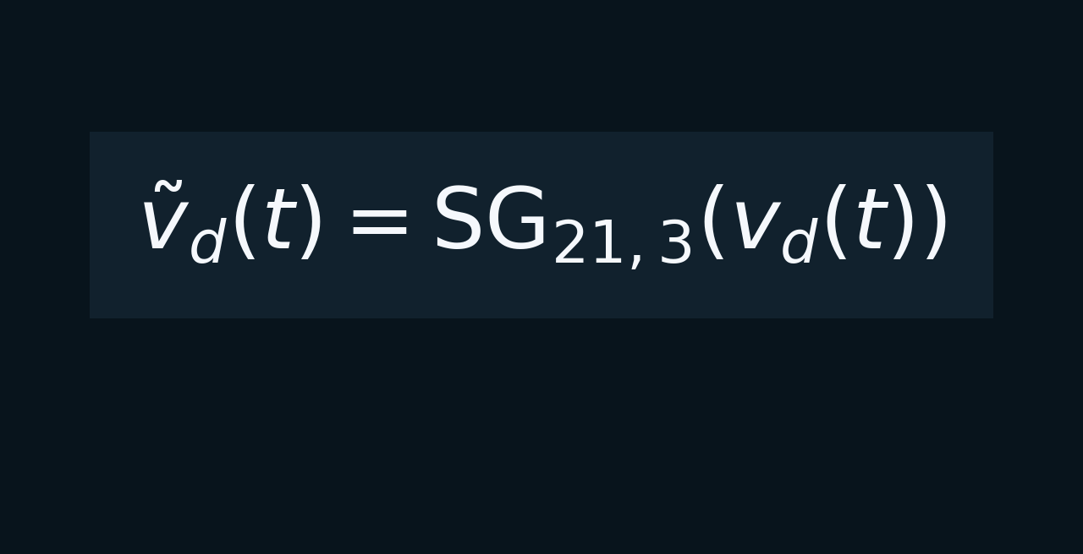
Smoothing the daily curve
Savitzky–Golay filtering (window 21, order 3) preserves irrigation pulses while reducing noise.
Raw hourly signal → daily mean → smoothed curve; note how the pulses remain visible.
An analytical equation card on the right summarises the filter definition.

Slide 6
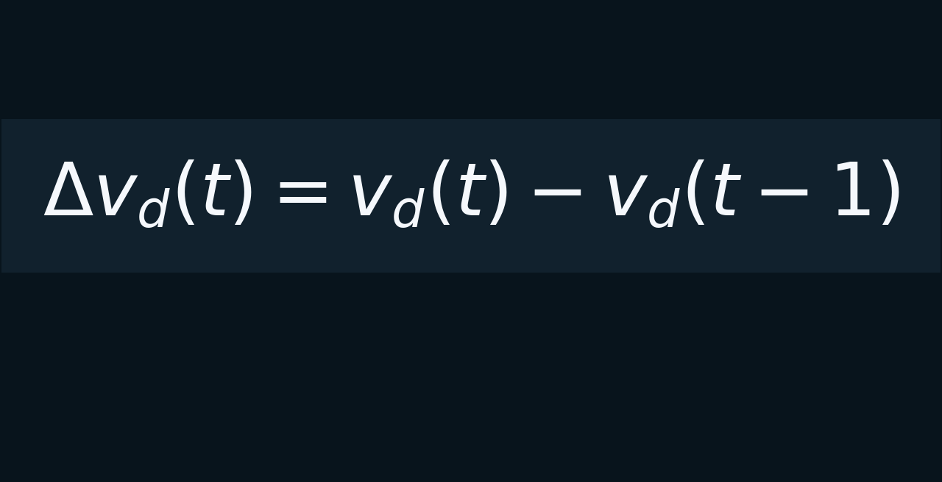
Drying velocity via derivatives
Taking the first difference highlights the rate of change rather than absolute water content.
Derivative signals are less sensitive to bias and capture drying speed after irrigation events.

Slide 7
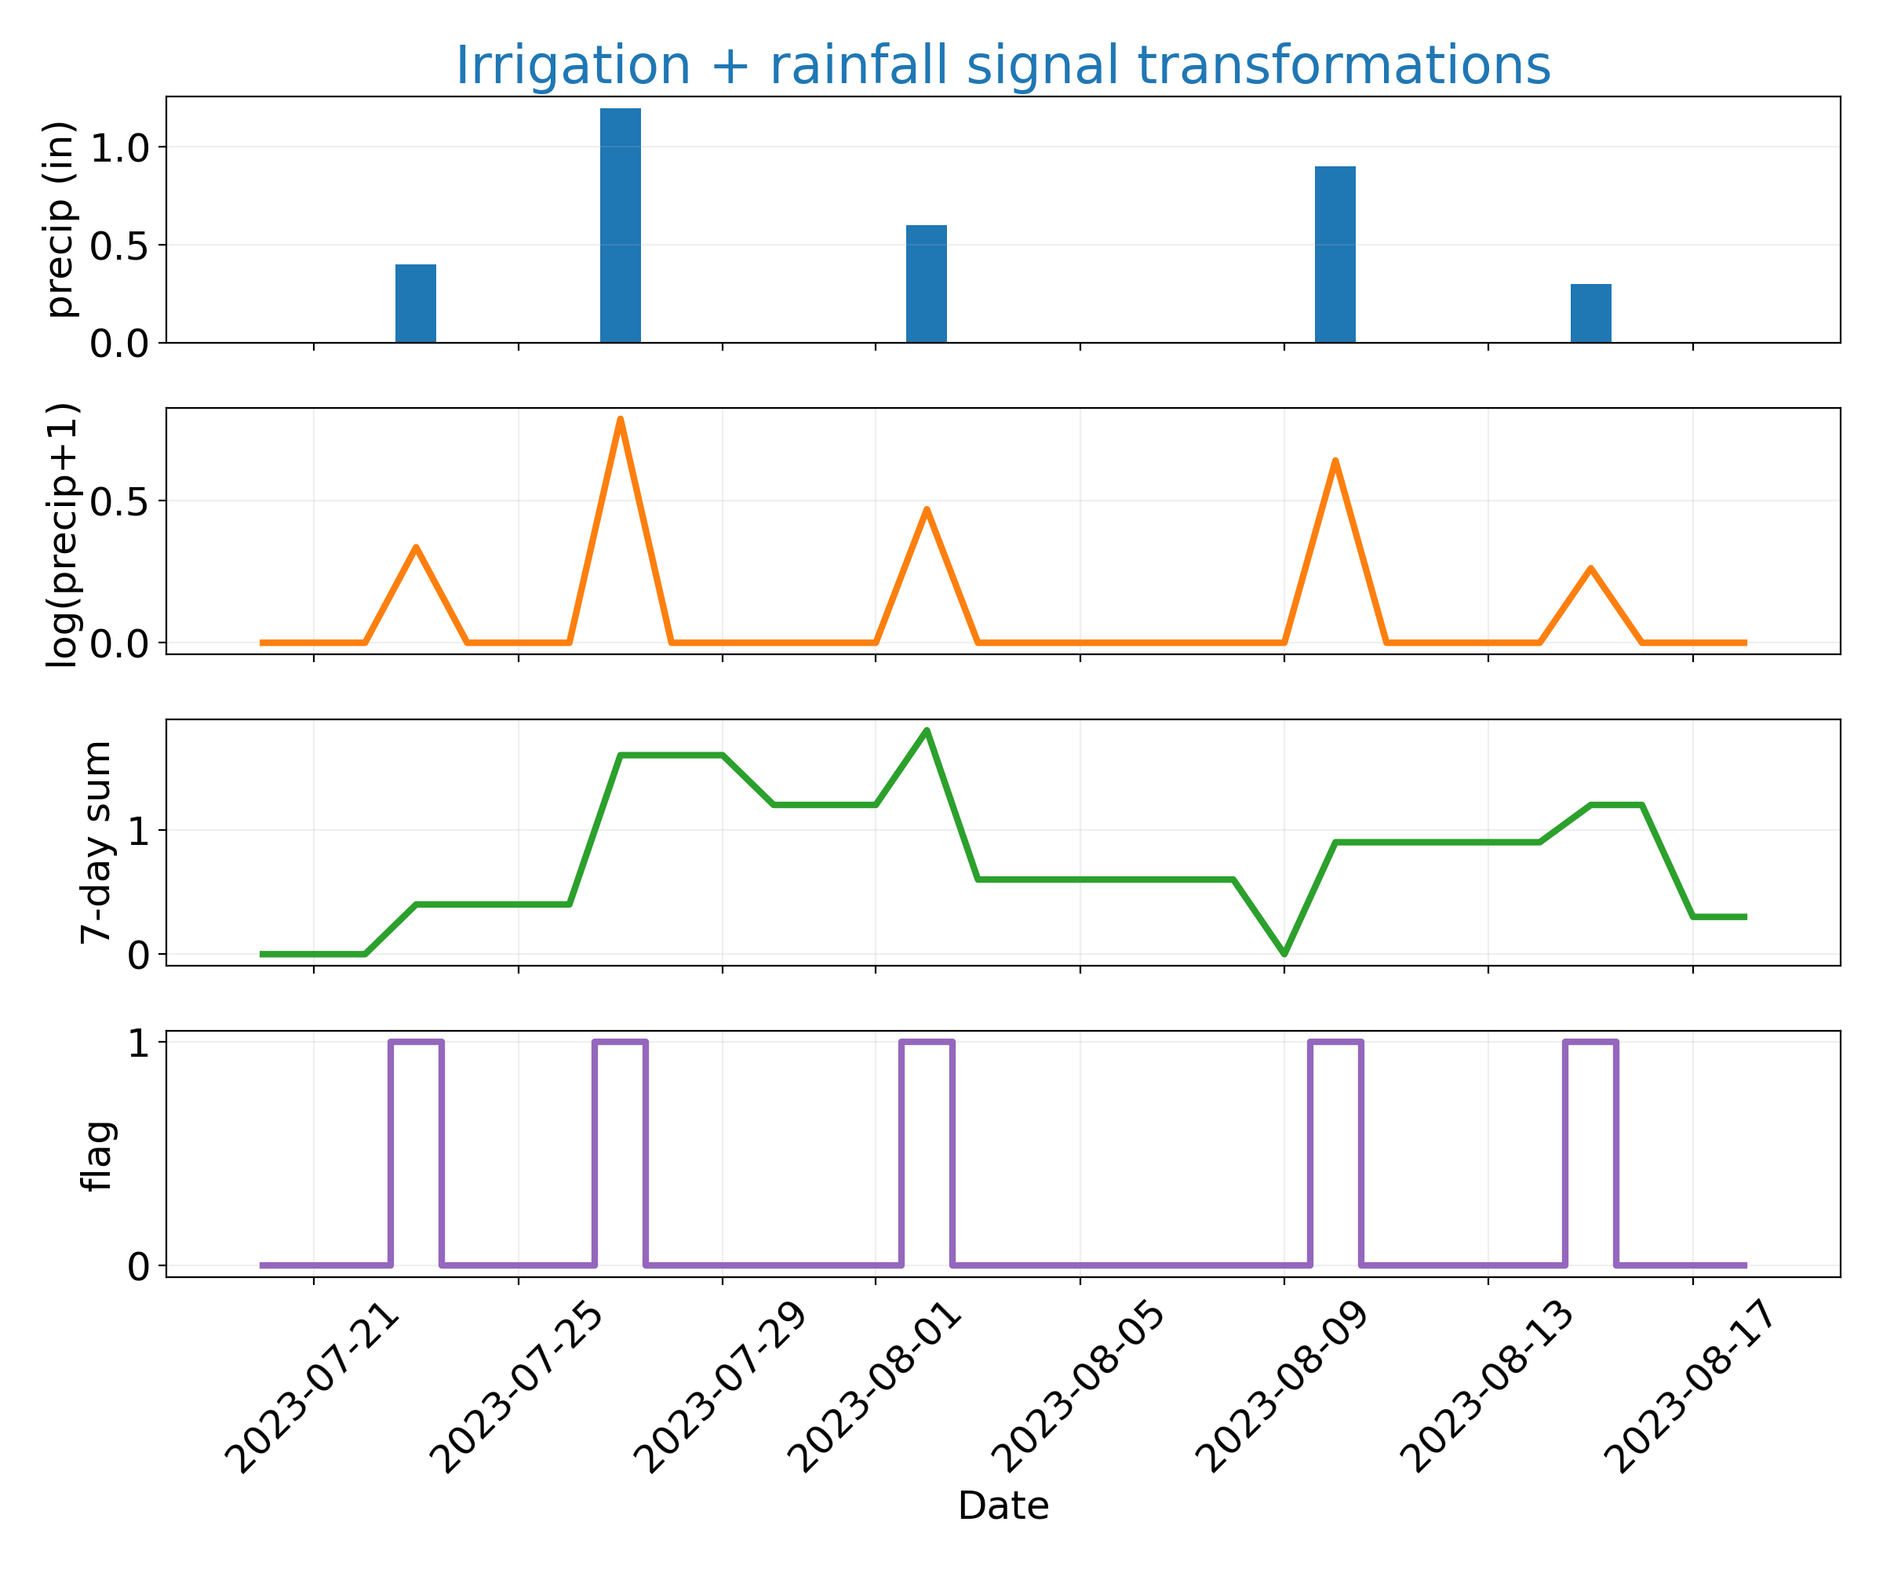
Irrigation feature engineering
Raw precipitation and irrigation totals are log‑transformed to tame skew.
A 7‑day running sum approximates weekly water budgets and soil recharge.
A binary flag indicates whether irrigation occurred on a given day.

Slide 8
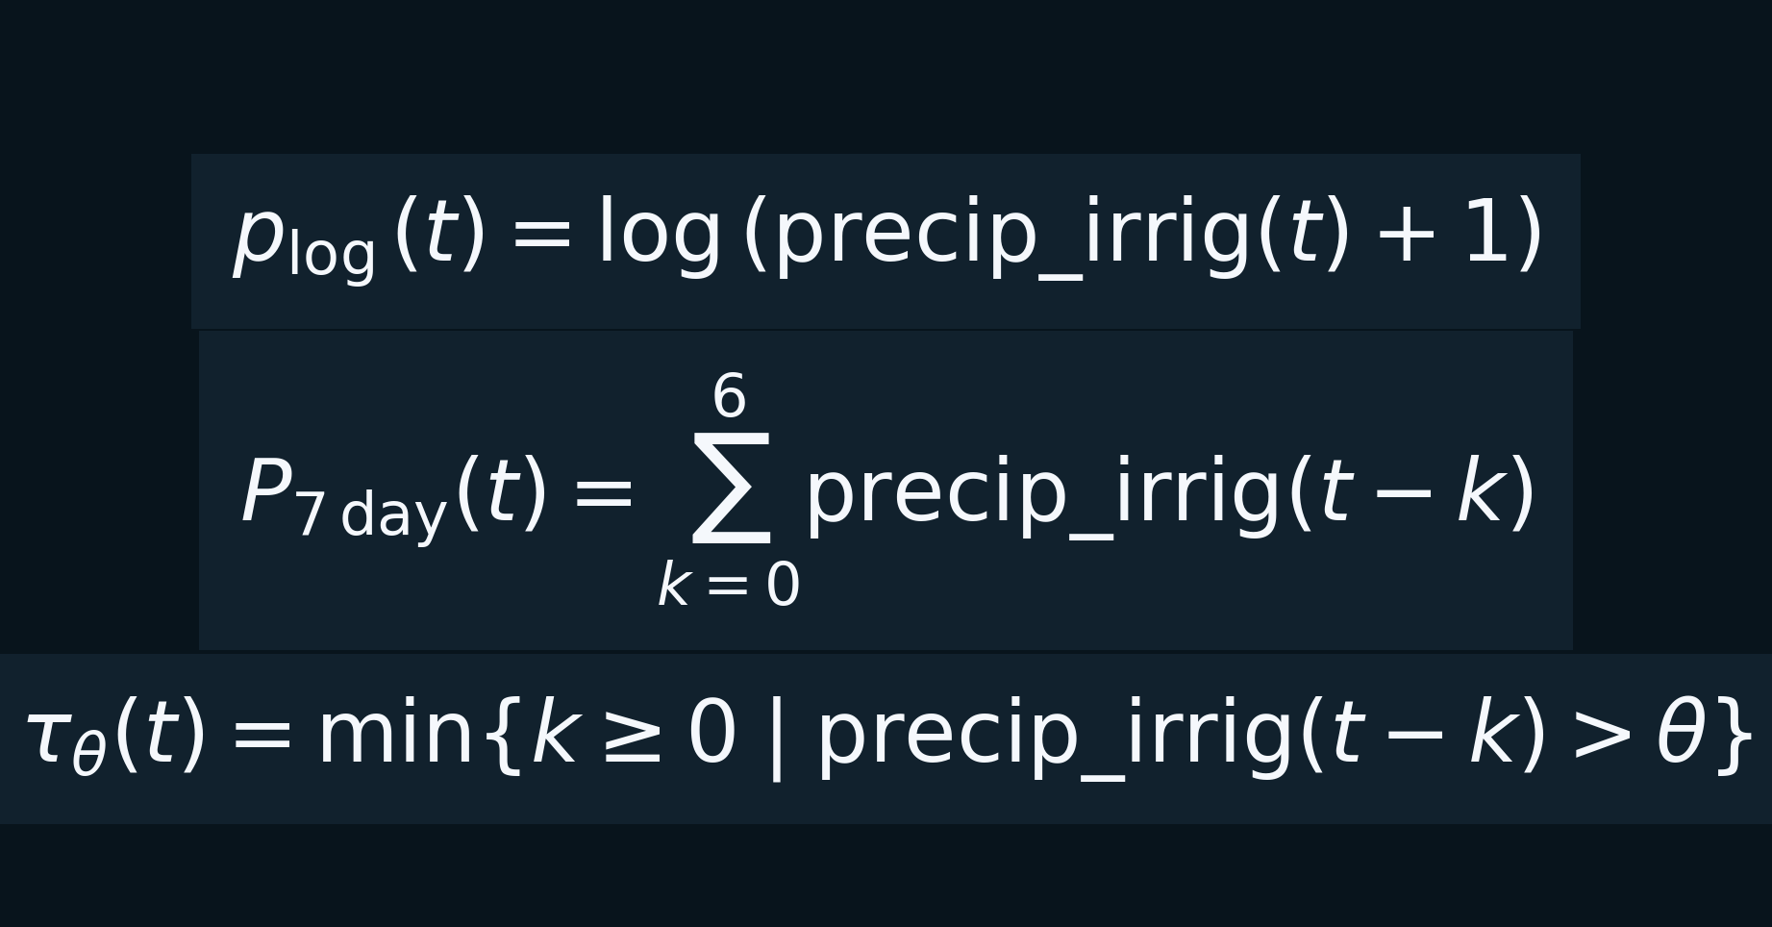
Log, sum and time‑since features
Logarithmic precipitation captures diminishing returns of large events.
Weekly cumulative precipitation summarises recent history for the model.
Time‑since last irrigation encodes rare event recency for the LSTM network.

Slide 9
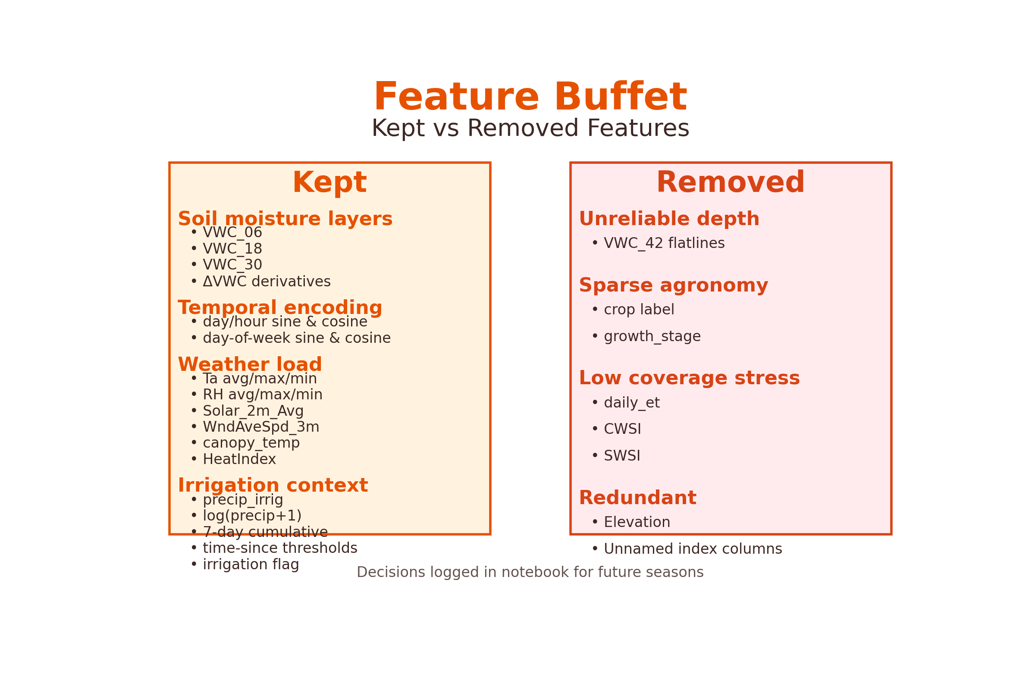
Feature buffet: kept vs cuts
Essential variables: multi‑depth VWC, temporal encodings & weather loads.
Irrigation context: raw totals, log‑transforms, 7‑day sums, time‑since & flags.
Removed: unreliable deep sensors, sparse agronomy labels & redundant columns.

Slide 10
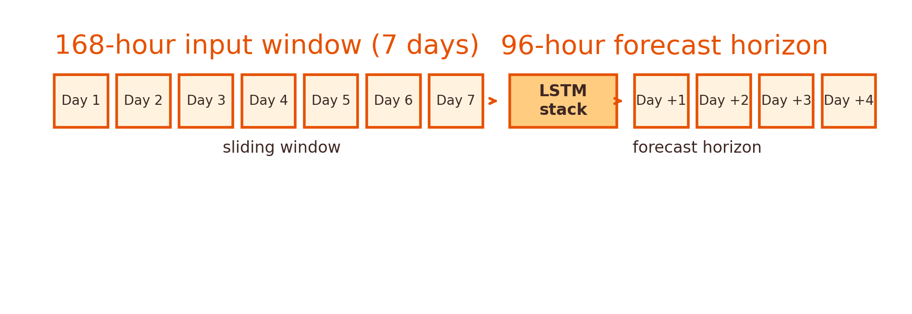
Sliding windows & forecast horizon
A 168‑hour (7‑day) window forms each input; a 96‑hour (4‑day) forecast follows; the window slides forward one day to build many training pairs.

Slide 11
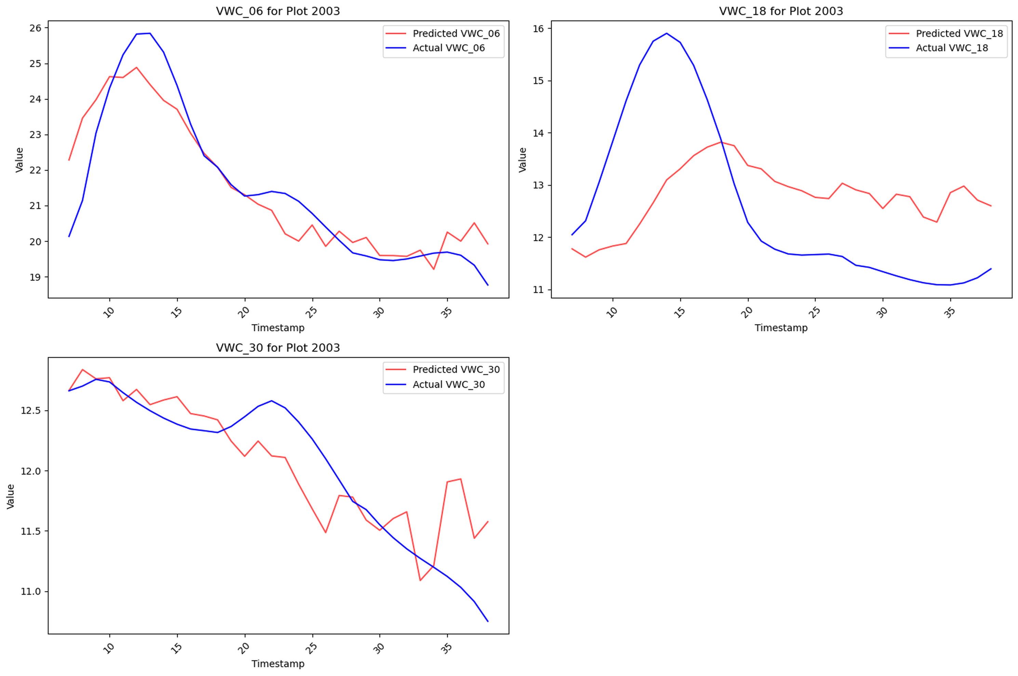
Case study: Plot 2003
Surface moisture (6″) reacts immediately to irrigation, while deeper layers (18″, 30″) lag behind.

Slide 12
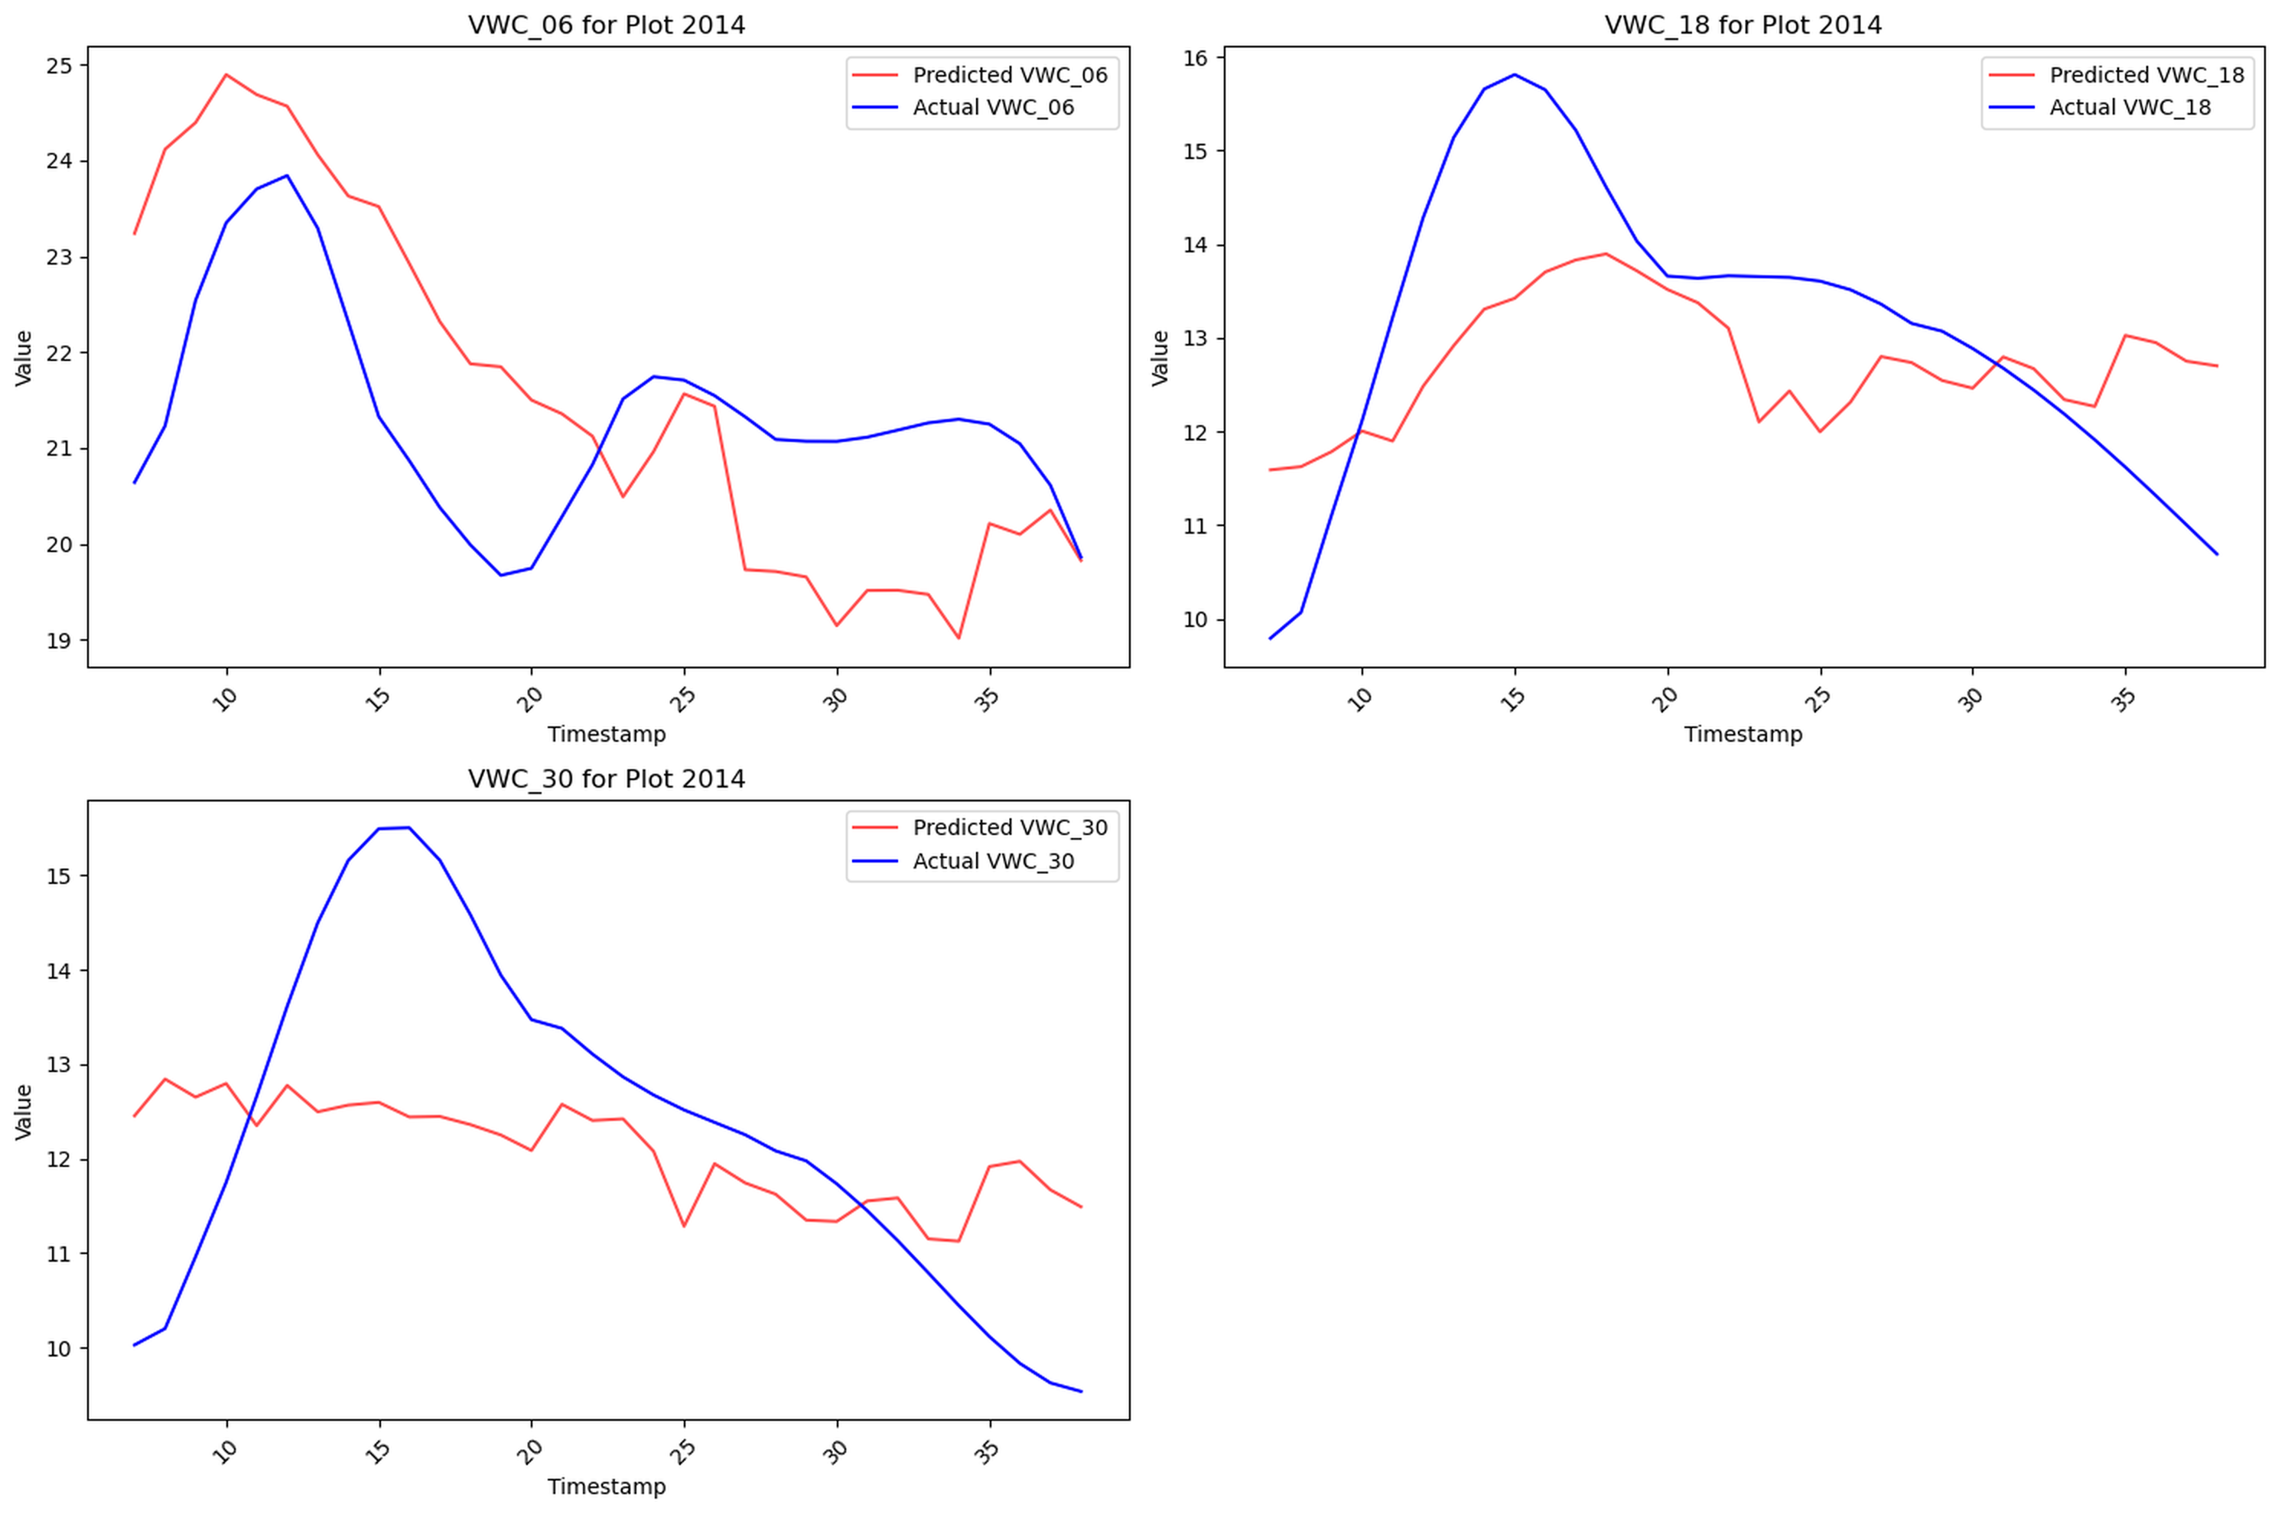
Case study: Plot 2014
Persistent positive bias arises because dry‑down exemplars were scarce during training.

Slide 13
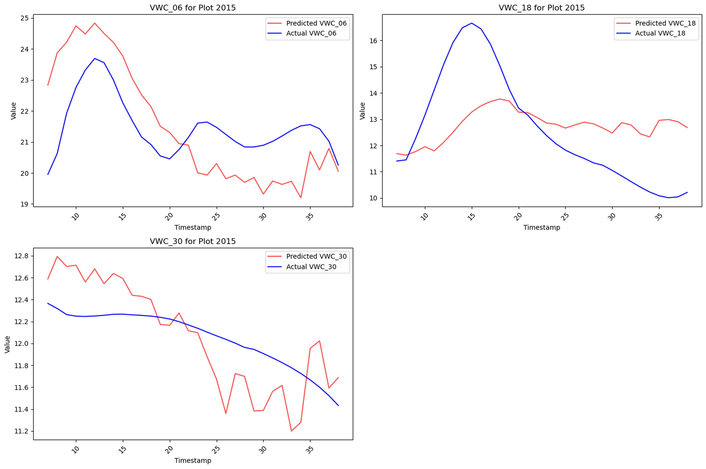
Case study: Plot 2015
A 48‑hour response delay exposes the fold reuse bug and highlights irrigation imbalance.

Slide 14
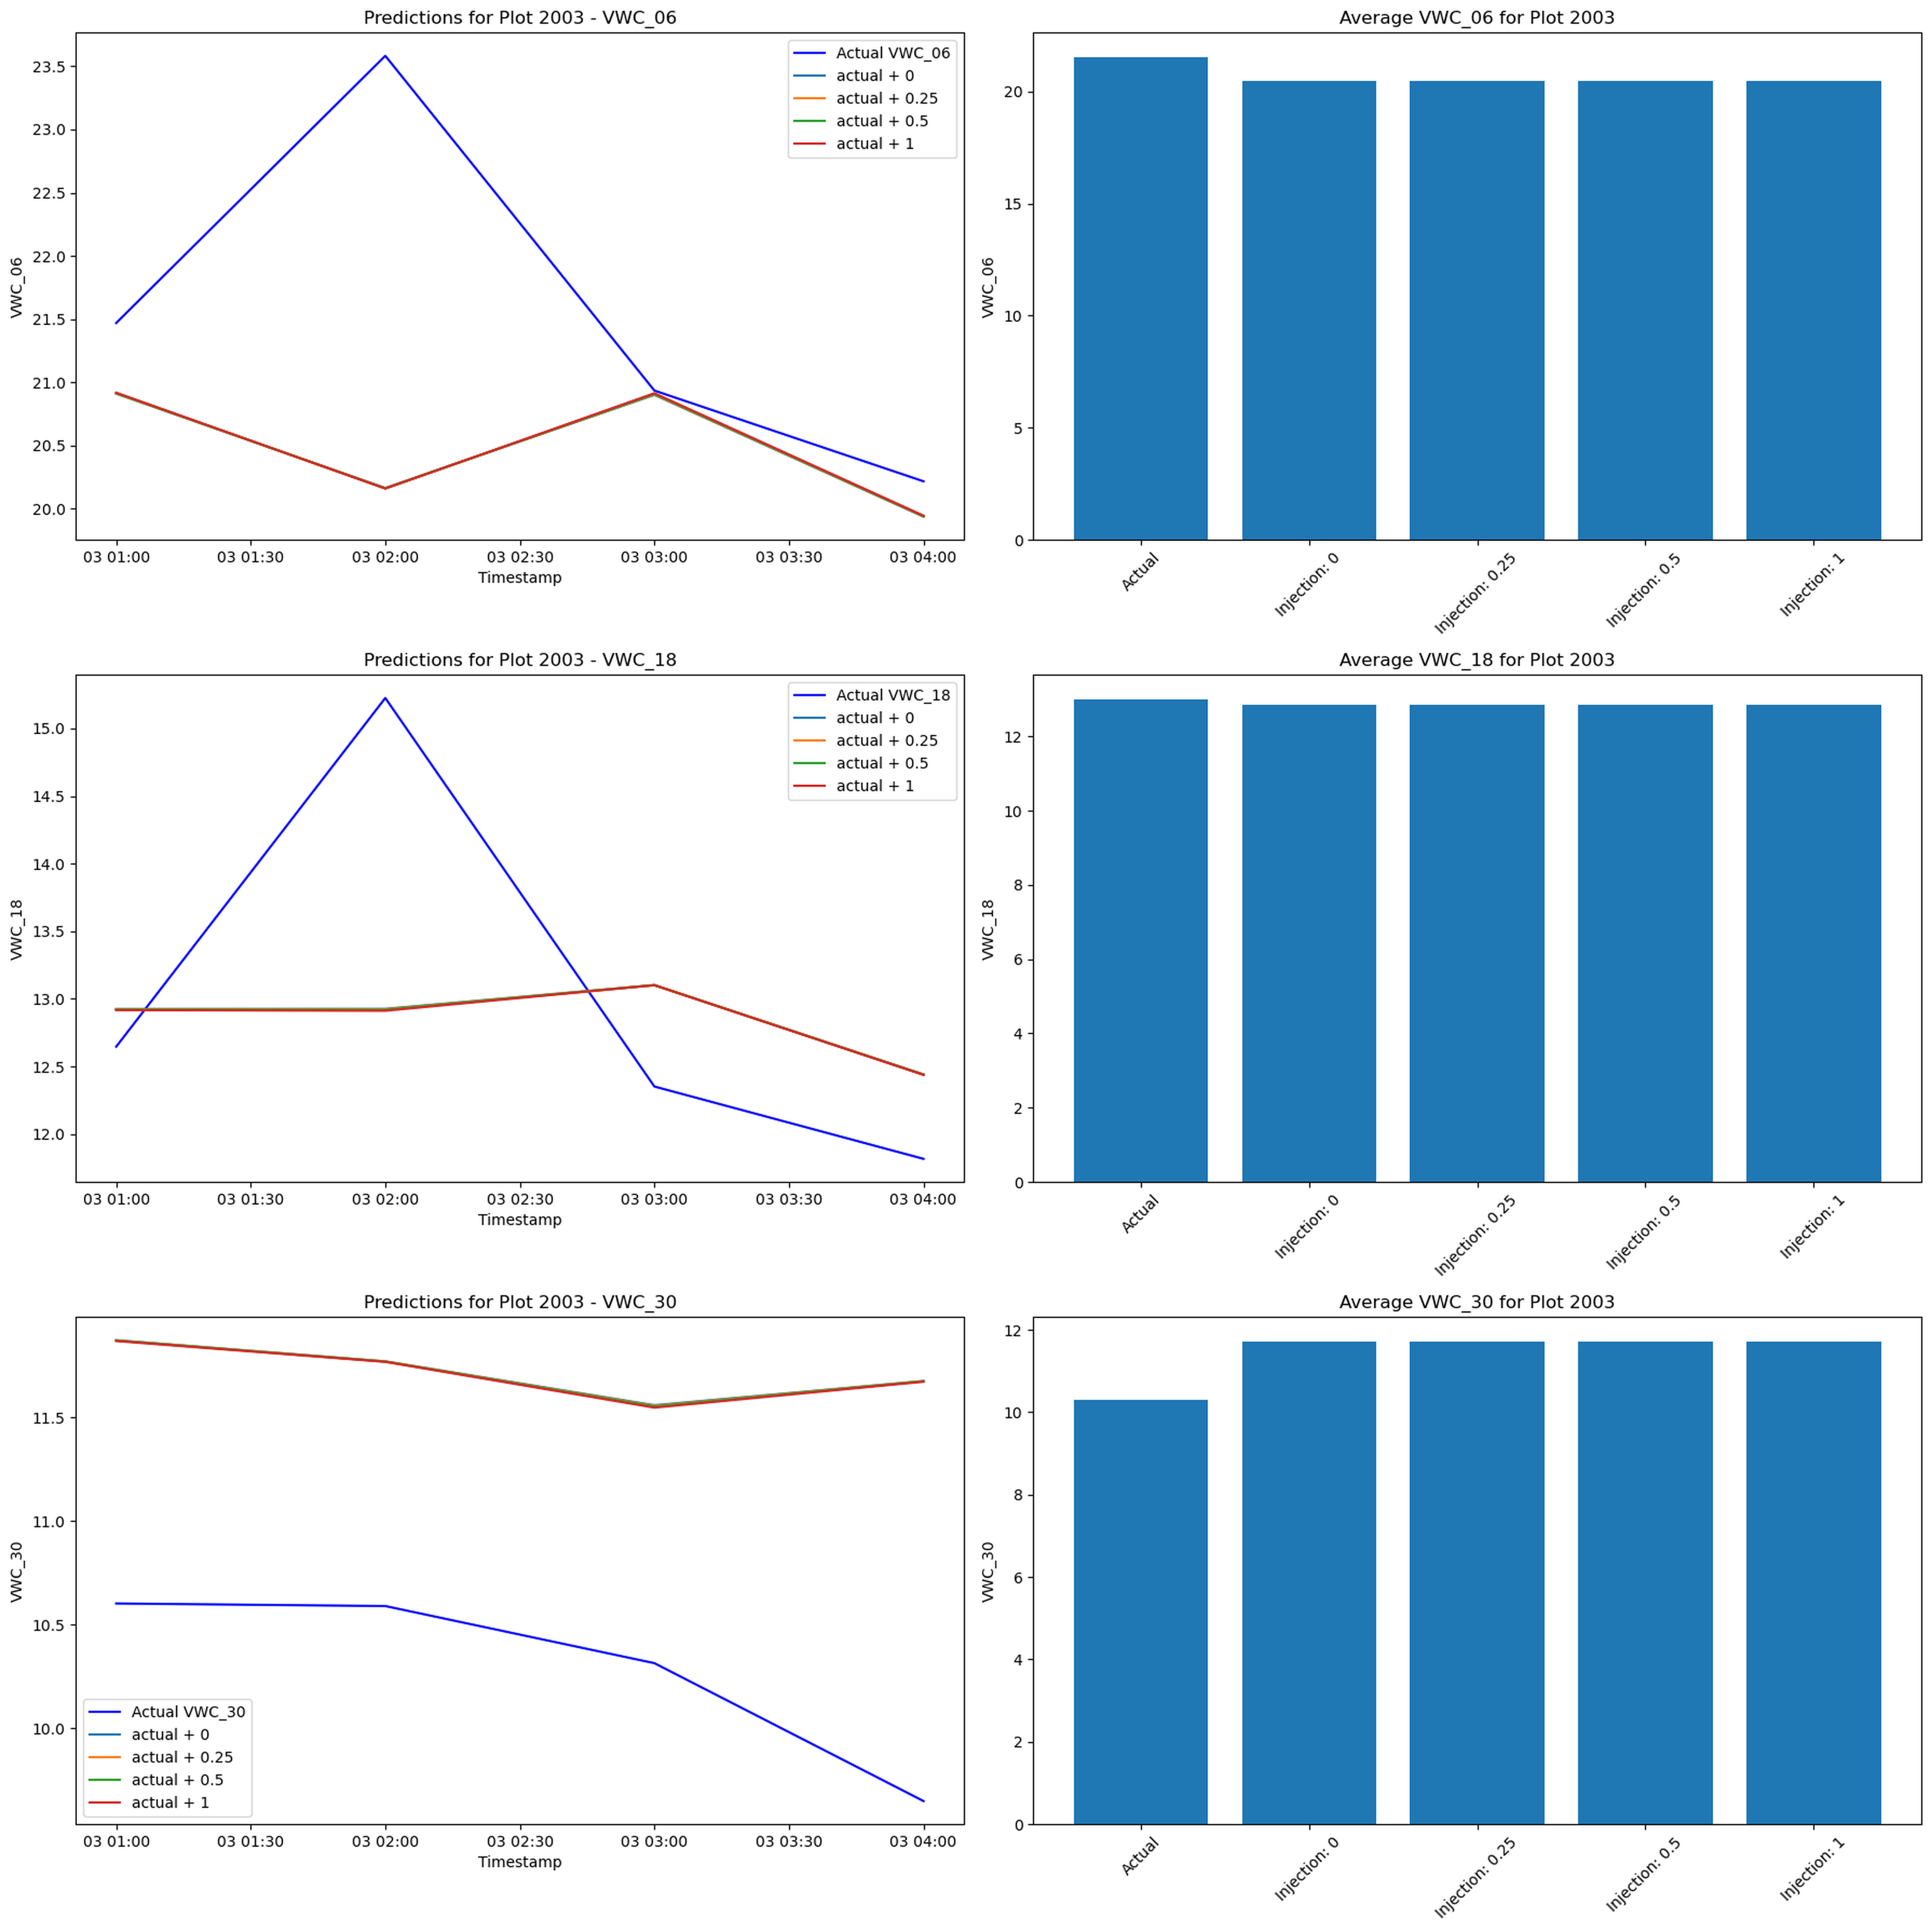
Injection stress test & wrap‑up
Injection stress test froze feature inputs; post‑scaling pulses pushed data off‑manifold.
Predictions remained flat despite injections, indicating missing context in engineered features.
Next steps: recompute features for scenario testing and repair the time series split logic.
The provided Python script can regenerate all visuals and tables for this deck once data is updated.

